Slide 1

Lic. en Sistemas
Inglés Nivel 1

Slide 2
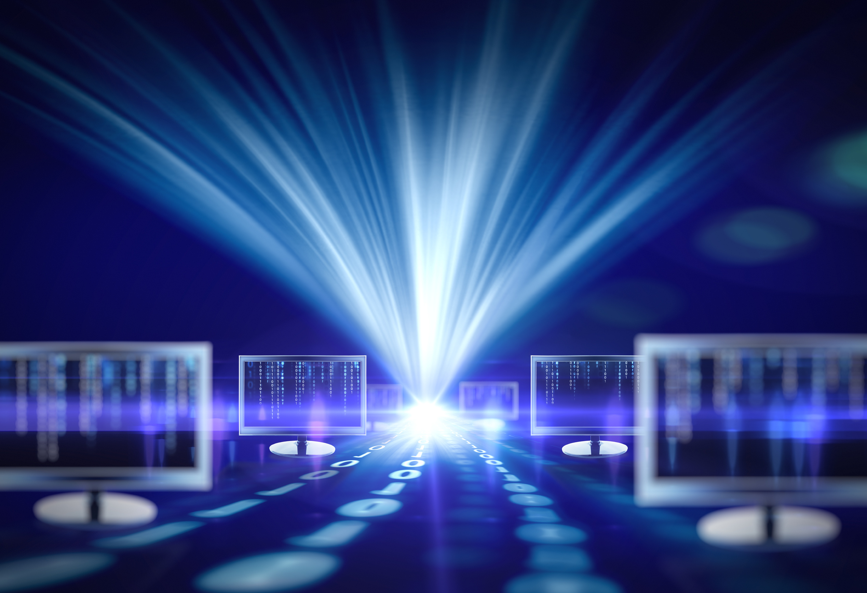
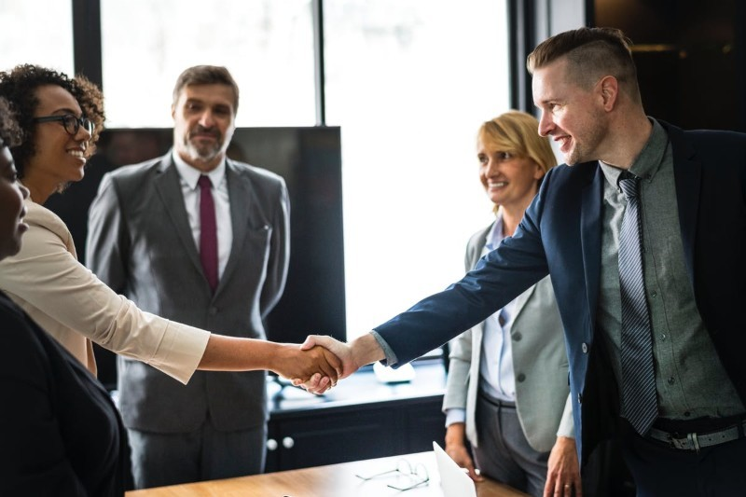
Unit 2
Computer Systems

Slide 3
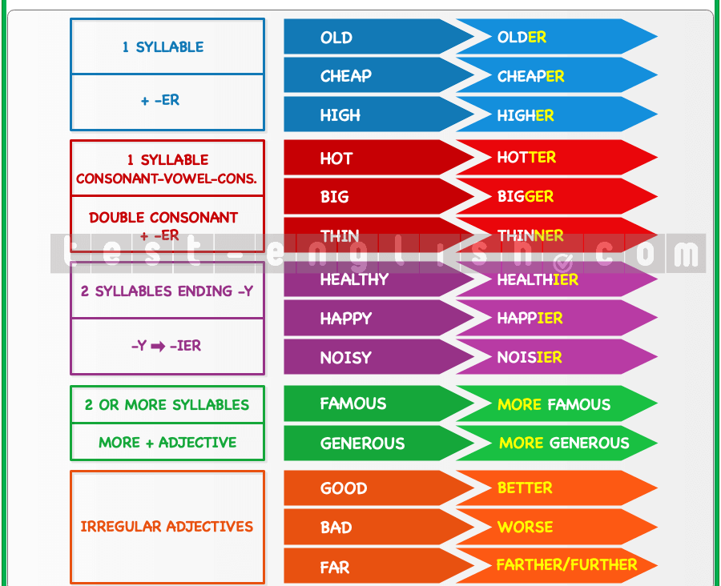
Comparatives Adjectives

Slide 4
Fill in the comparative form of the adjective of the first sentence.
1. Sue's car isn't very big. She wants a _______ car.
2. This house isn't very modern. I like _______ houses.
3. You're not very tall. Your brother is _______ .
4. Bill doesn't work very hard. I work _______.
5. My chair isn't very comfortable. Your chair is _______.
6. Jill's idea wasn't very good. My idea was _______.
7. These flowers aren't very nice. The blue ones are _______.
8. My case isn't very heavy. Your case is _______.
9. I'm not very interested in sports. I'm _______ in reading.
10. It isn't very warm today. Yesterday it was _______.
11. These tomatoes aren't very good. The other ones taste _______.
12. Ireland isn't very big. France is _______.
13. Liverpool isn't very beautiful. London is _______.
14. This knife isn't very sharp. Have you got a _______ one?
15. People today aren't very polite. In the past they were _______ .

Slide 5
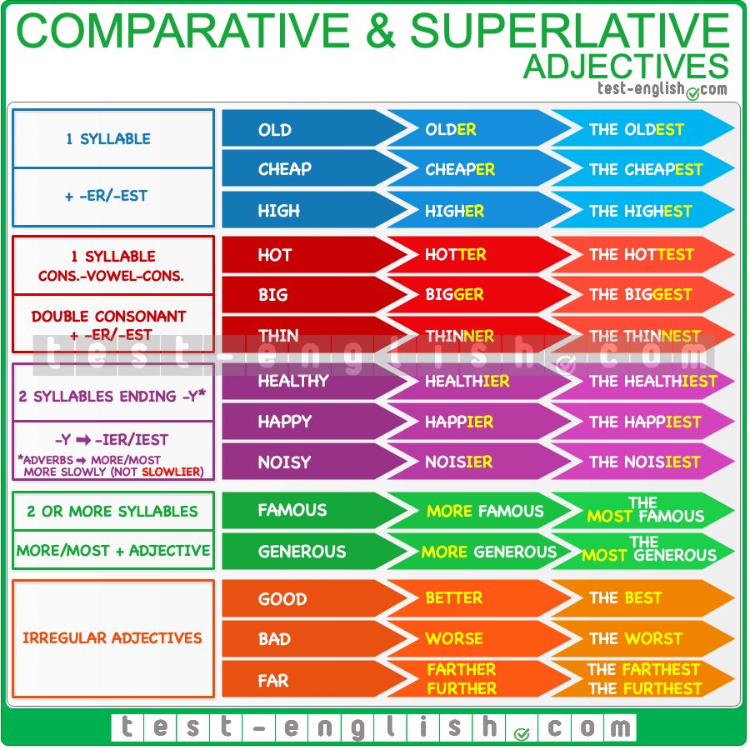

Slide 6
Fill in the superlative forms of the adjectives in brackets.
1. The moon is the _________ planet to earth. (close)
2. Jupiter is the _________ planet in our solar system. (large)
3. Sirius is the _________ star we can see from earth. (brilliant)
4. Venus is the _________ planet in our solar system. (hot)
5. Ceres is the _________ asteroid in our solar system. (big)
6. The Energya is the _________ rocket. (powerful)
7. Karl Henize was the _________ man in space. He was 58 years old. (old)
8. Saturn is the _________ planet. (beautiful)
9. Venus is the _________ planet in our solar system. (bright)
10. The Apollo project was the ____ space programme. It cost 25 541 400 000 dollars. (expensive)

Slide 7
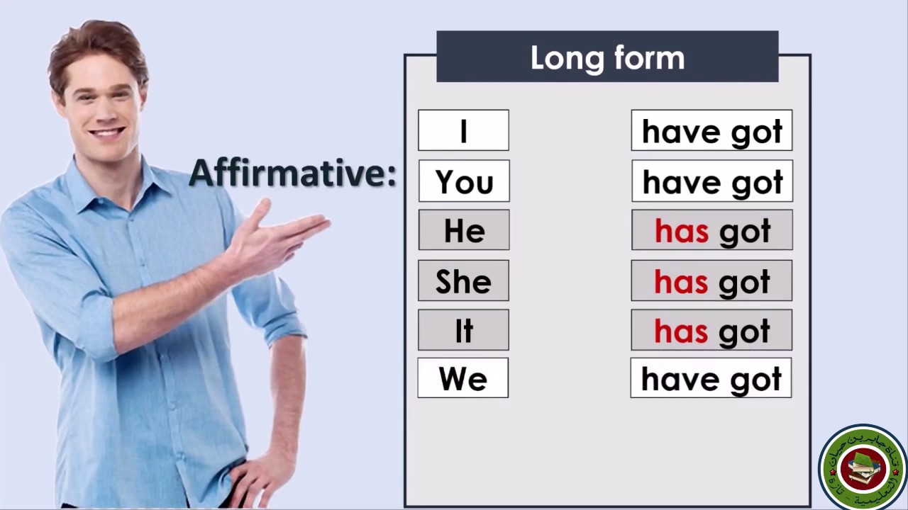

Slide 8
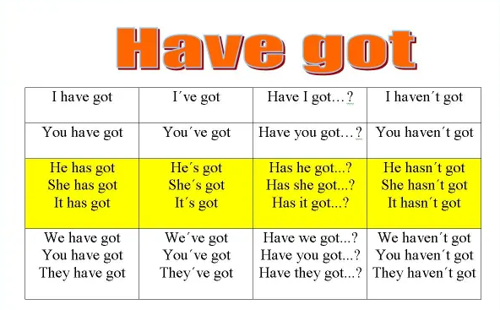

Slide 9
Complete the sentences with have got or has got.
If there is a (-) use haven't got or hasn't got.
1. My sisters ______ long hair.
2. I can't open the door. I ______ a key. (-)
3. We ______ an apple tree in the garden.
4. Robert ______ a lot of friends in school.
5. They ______ two cats and a dog.
6. Ben ______ a lot of books. (-)
7. I ______ enough time to go on holidays.
8. My friend ______ an orange basketball.
9. Betty and Frank ______ a really nice aunt.
10. Hurry up! We ______ much time. (-)

Slide 10
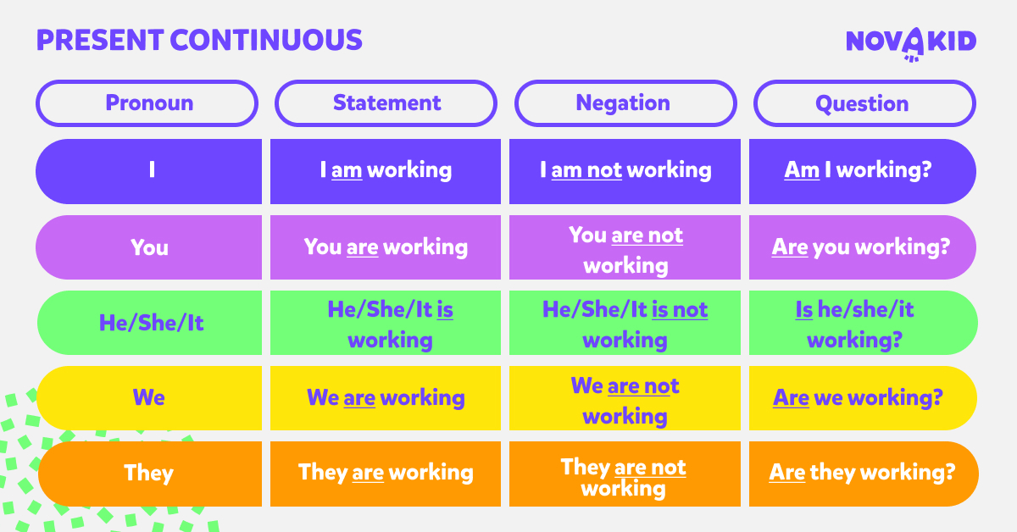

Slide 11
Exercise 5) Fill in the present progressive. Use the verbs in BOLD. Example: He often buys a new notebook. Look, he is buying a notebook again.
1. He usually goes to school. Look, he ________________ to school! 2. He often drinks a coffee. Look, he ________________ a coffee! 3. I swim every day. Look, I ________________ ! 4. She washes her hair every day. Look, she________________ her hair! 5. The cat always drinks its milk. Look, it ________________ its milk!
Exercise 6) Fill in the words from the box. Use present progressive. play - listen - help - read - act - work – clean Sally and her friends _______ in the garden. They __________ for a video. Her mother ______ a book. Her father _____________ in the garden. Dave _______ to music on his iPad. Her brothers Ben and Frank, ______________ their bikes. Ben's friend __________ his mum in the garden.

Slide 12
Online Practice
Comparative & Superlative
https://elt.oup.com/student/solutions/preint/grammar/grammar_04_012e?cc=ar&selLanguage=es
https://test-english.com/grammar-points/b1/comparative-superlative-adjectives-adverbs/
https://wordwall.net/es/resource/37069128/english/comparatives-and-superlatives-2
Have / Has got
https://test-english.com/grammar-points/a1/have-got/
https://wordwall.net/resource/721783/have-got-has-got
https://www.englisch-hilfen.de/en/exercises/tenses/have_got.htm
Present Continuous
https://test-english.com/grammar-points/a1/present-continuous/
https://www.perfect-english-grammar.com/present-continuous-exercise-1.html
https://elt.oup.com/student/solutions/elementary/grammar/grammar_04_012e?cc=ar&selLanguage=es

